Slide 1
Report to big mountain resort management

Slide 2
Executive Summary
Big Mountain Resort is looking for ways to cover $1.54M in incremental operating costs presented by its new chair lift.
The key lever which BMR management asked us to look at was pricing strategy for Adult weekday/weekend tickets, with the hypothesis that BMR tickets were underpriced for the facilities offered by BMR.
Based on our analysis of ticket pricing by other ski resorts in its market share, BMR would be justified in increasing its Adult ticket price by up to 16%, or to $94 per ticket. While there is nuance to this number, even a $1 increase in ticket prices would more than cover the incremental operating costs of the chairlift.
We have also conducted analysis of actions currently being contemplated by BMR management, and can recommend the following as cost-savings measures:
Closing at least one ski run, and sequencing any additional run closures in waves
Adding a new run that increases total vertical drop with a new chair lift

Slide 3
Problem identification
With the addition of a new chair lift, BMR has added $1.54M in operating costs to this season. BMR management would like to implement either new revenue-generating or cost-saving measures to preserve its margin.
BMR management also suspects its tickets are underpriced based on the facilities it offers, despite its pricing strategy of charging a premium above average price in its market segment
Based on this, we pursued a strategy of analyzing BMR’s ticket price, with a focus on 1) determining whether it was underpriced compared to other resorts in its market share and 2) whether an increased ticket price could cover the incremental operating costs of the new chair lift
We were also provided a list of actions shortlisted by BMR management to generate new revenue or increase savings, and used our pricing model to determine the potential effectiveness of these strategies

Slide 4
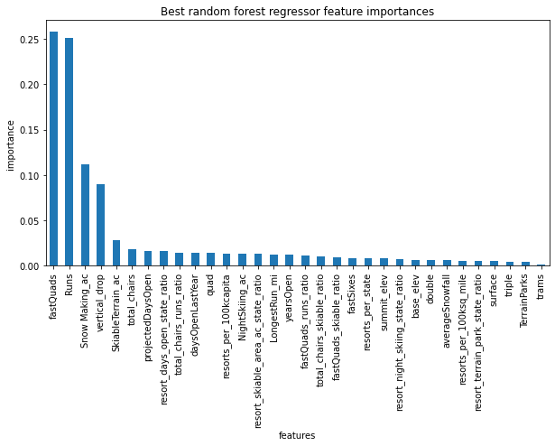
Modeling results and analysis
We were provided with a dataset comprising 27 features for 330 different resorts in BMR’s market share. We removed resorts missing ticket pricing information from the dataset and generated some synthetic scaling features (e.g., resorts per 100k capita in a state) to provide additional context.
For our model, we determined a Random Forest regressor to determine which features were most important in determining ticket price. You can see in the figure to the right that the number of fast quads, number of runs, snow making acreage, and vertical drop were weighted significantly in this model.

Slide 5
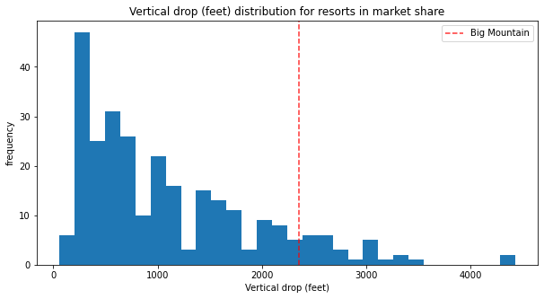
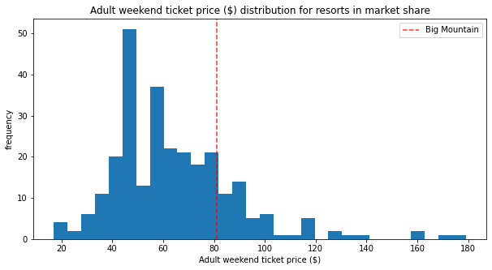
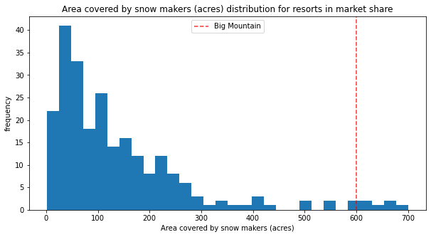
Modeling results and analysis
Our model predicted that BMR could increase its ticket price to $94 from $81 based on the features it had relative to other resorts.
While you can see in the figure below that BMR’s ticket price is currently in the upper part of the ticket price distribution, it also is in the upper part of the distribution for figures which are most determinative of ticket pricing for all resorts (two illustrative examples to the right).

Slide 6
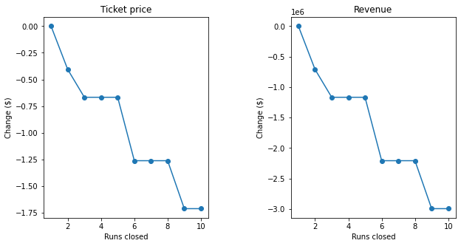
Modeling results and analysis
We also conducted analyses of four potential actions being contemplated by BMR management:
Permanently closing down up to 10 of the least used runs. This doesn't impact any other resort statistics.
Increase the vertical drop by adding a run to a point 150 feet lower down but requiring the installation of an additional chair lift to bring skiers back up, without additional snow making coverage
Same as number 2, but adding 2 acres of snow making cover
Increase the longest run by 0.2 mile to boast 3.5 miles length, requiring an additional snow making coverage of 4 acres
Our model suggested that only options one and two would generate positive pressure on ticket prices.
In terms of closing runs, the figure to the right demonstrates the price impact of closing between1-10 runs, which led to our recommendation of closing at least 1 run to minimize operating costs and sequencing any additional closures in waves

Slide 7
CONCLUSIONS
Based on the data provided, we can conclude that BMR is underpricing its tickets relative to its market share and can generate significant incremental revenue through ticket price changes alone
There are several other actions BMR management can take to minimize costs or maximize revenue generation, and our model provides the list of features that, if impacted, could maximize impact on margin
Our model provides a structure for BMR to assess its pricing against market share on a regular basis, ensuring it is maximizing potential revenue from its features.

